Slide 1
Digital Portfolio
STUDENT NAME: Mohammed Anas N
REGISTER NO AND NMID: 2428M0087 and
DEPARTMENT: Data science
COLLEGE: Sri krishna Adithya college of arts and science

Slide 2
personal digital portfolio website

Slide 3


AGENDA
Problem Statement
Project Overview
End Users
Tools and Technologies
Portfolio design and Layout
Features and Functionality
Results and Screenshots
Conclusion
Github Link
3/21/2024 Annual Review

Slide 4

PROBLEM STATEMENT
In today’s digital era, professionals and students need an online presence to showcase their skills, projects, and achievements. Traditional resumes are limited in presenting creativity and interactive elements. A personal portfolio website solves this by providing a dynamic and visually engaging platform to highlight one’s expertise and work.

Slide 5

PROJECT OVERVIEW
This project is a personal digital portfolio website designed using HTML and CSS. It provides an interactive and responsive platform to showcase academic background, technical skills, and completed projects. The website is structured with user-friendly navigation and modern UI/UX principles.

Slide 6

WHO ARE THE END USERS?
Students who want to present their skills for internships or placements.
Professionals who wish to highlight their achievements online.
Recruiters and hiring managers looking for candidate profiles.
Anyone seeking inspiration or collaboration opportunities.

Slide 7

TOOLS AND TECHNIQUES
HTML5 – For content structure.
CSS3 – For styling and responsive design.
Visual Studio Code – As the development environment.
GitHub – For version control and deployment.

Slide 8
POTFOLIO DESIGN AND LAYOUT
Home section – Introduction with name, role, and tagline.
About Section – Personal background and career goals.
Skills Section – Technical and soft skills displayed with progress bars or icons.
Projects Section – List of completed works with descriptions and links.
Contact Section – Contact form and social media links.
8

Slide 9
FEATURES AND FUNCTIONALITY
Responsive design for mobile, tablet, and desktop.
Easy navigation with menu bar and smooth scrolling.
Project showcase with descriptions and links. Interactive hover effects and animations.
Interactive hover effects and animations.
Contact form for communication.

Slide 10
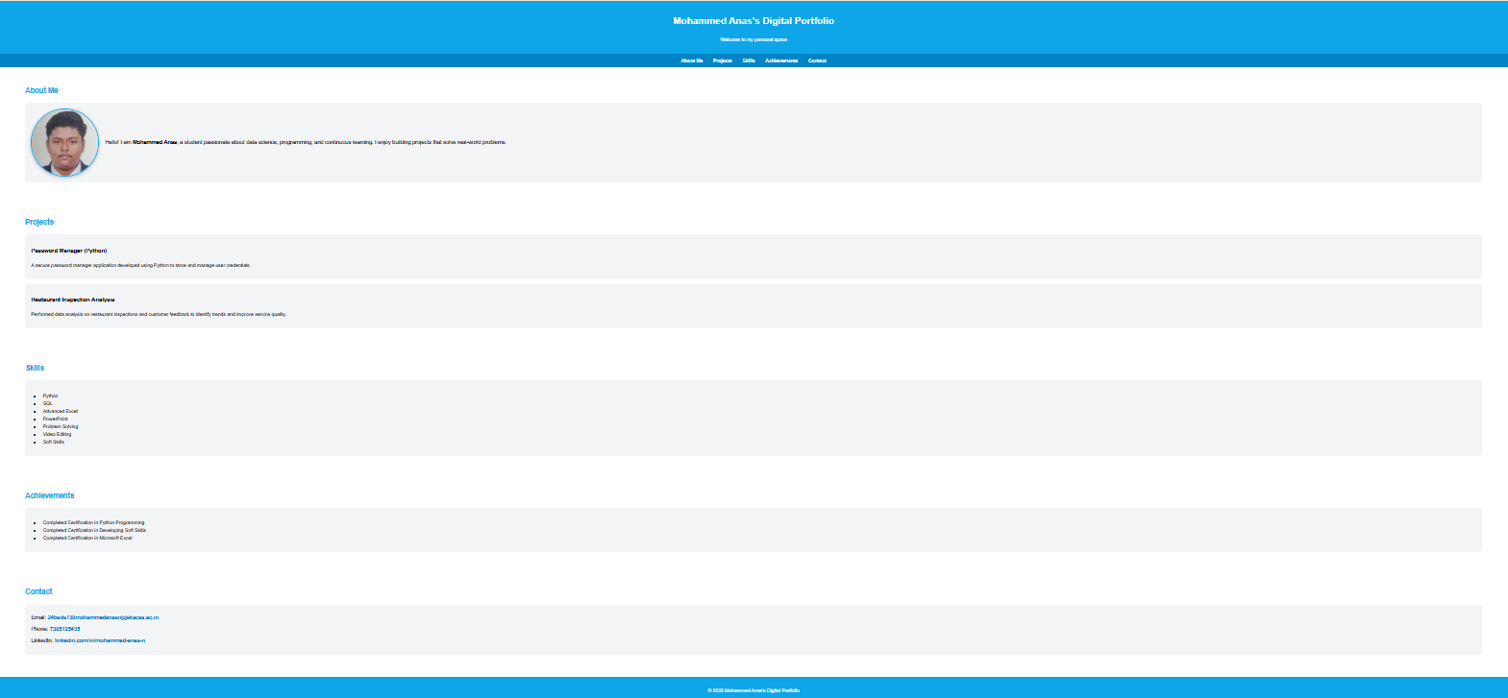

RESULTS AND SCREENSHOTS
Result: A fully responsive, modern portfolio accessible on multiple devices.
Screenshots:
3/21/2024 Annual Review
10

Slide 11
CONCLUSION
The portfolio project demonstrates the use of web development skills in creating a professional digital identity. It highlights technical expertise, creativity, and an understanding of responsive design principles. The project can be extended further by adding backend functionality and hosting on a live server.
11

Slide 12
Github link:
https://github.com/24bsds130mohammedanasn-netizen/project.git

